Slide 1

ANALYZE AND VISUALIZE COVID-19 CASE TRENDS AND VACCINATION DATA BY COUNTRY
Himanshu Kumar Singh
Jiya Patel
Jiya Chaudhari
Shah Chaitya

Slide 2
WHY TRACK COVID-19 IMPACT?
COVID-19 has significantly impacted global health, economies, and daily life. By analyzing case and vaccination trends, we can better understand the pandemic’s progression, identify areas needing intervention, and support informed policy-making. This presentation explores key data insights to address these challenges.

Slide 3
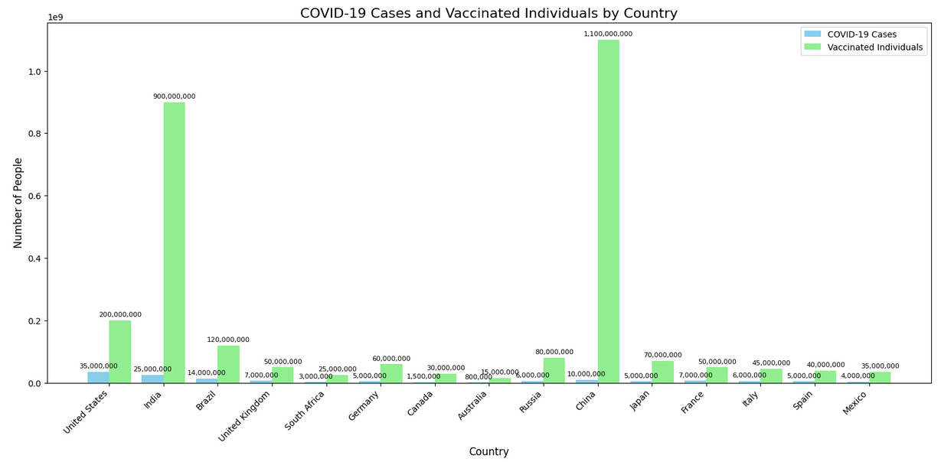
COVID-19 CASES AND VACCINATED BY COUNTRY
1)CHINA AND INDIA DOMINATE IN VACCINATIONS, WITH 900M+ AND 200M PEOPLE VACCINATED, FAR SURPASSING THEIR REPORTED COVID-19 CASES.
2)VACCINATION NUMBERS GLOBALLY ARE MUCH HIGHER THAN COVID-19 CASES, REFLECTING WIDESPREAD EFFORTS TO CONTROL THE PANDEMIC.
3)THE DATA REVEALS DISPARITIES IN VACCINATION RATES, HIGHLIGHTING VARIATIONS IN HEALTHCARE INFRASTRUCTURE AND ACCESSIBILITY.
4)SOME COUNTRIES SHOW LOWER VACCINATION FIGURES, INDICATING CHALLENGES LIKE DISTRIBUTION, AVAILABILITY, OR VACCINE HESITANCY.

Slide 4
Execution Steps
1) INSTALL TOOLS:
DOWNLOAD AND INSTALL VS CODE.
DOWNLOAD AND INSTALL PYTHON (CHECK "ADD PYTHON TO PATH").
4)CREATE SCRIPT:
CREATE GRAPH_OUTPUT.PY IN VS CODE.
PASTE AND SAVE THE PROVIDED CODE.
2) INSTALL LIBRARIES: IN VS CODE TERMINAL (CTRL+`), RUN:
pip install pandas matplotlib
5)RUN SCRIPT: IN THE TERMINAL, RUN:
python graph_output.py
6)OUTPUT:
View and save graphs:
total_new_cases_by_cOUNTRY.PNG
TOTAL_VACCINATIONS_BY_COUNTRY.PNG
NEW_CASES_TREND_OVER_TIME.PNG
VACCINATIONS_TREND_OVER_TIME.PNG
3)PREPARE DATASET: PLACE COVID_TRENDS_VACCINATION.CSV IN THE SAME DIRECTORY WITH THESE COLUMNS:
DATE (YYYY-MM-DD), COUNTRY, NEW CASES, VACCINATIONS.

Slide 5

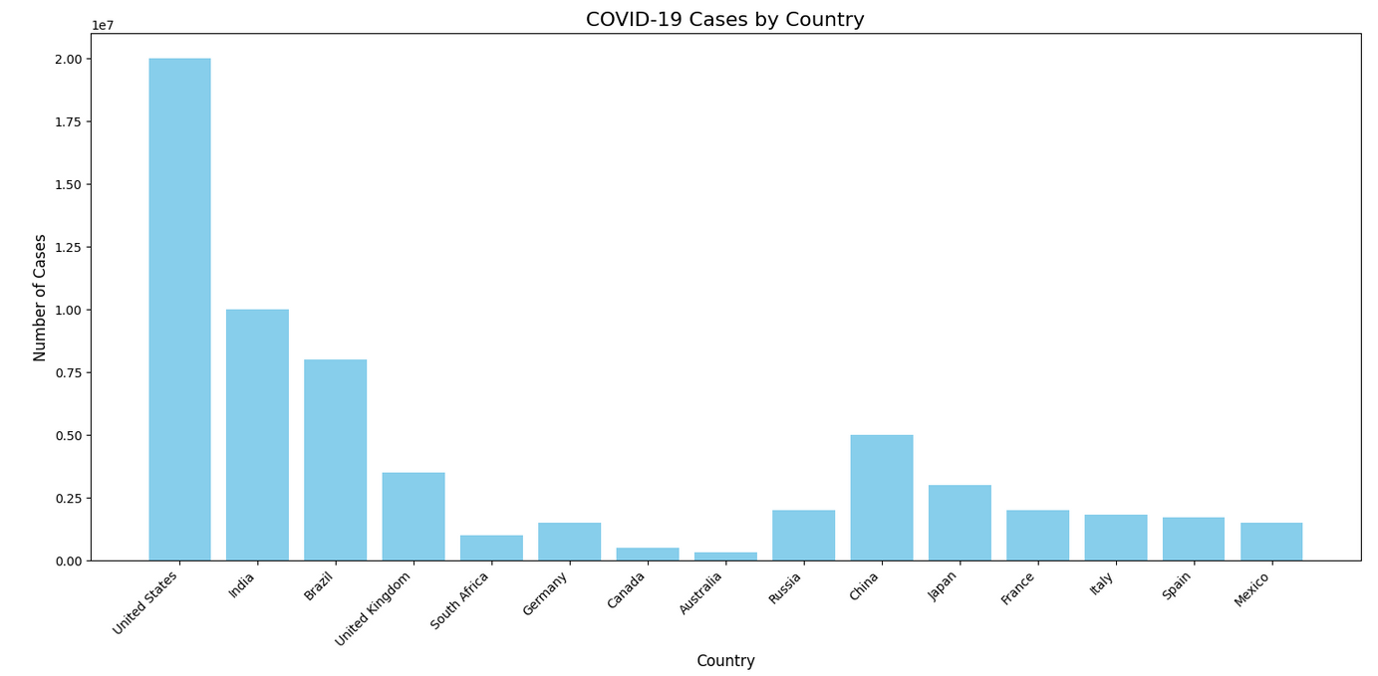
High-Burden Nations Facing Continued Outbreaks
High-Burden Nations Facing Continued Outbreaks
United States: Over 40,000 daily new cases.
India: Approximately 30,000 new cases daily.
Japan: Over 20,000 new daily cases linked to increased travel and emerging variants.
South Africa: Around 15,000 daily cases fueled by variant spread and inconsistent health measures.
Brazil: Approximately 18,000 daily cases due to urban density and ongoing community transmission.

Slide 6
LEADERS IN VACCINATION CAMPAIGNS
Global vaccination efforts showcase significant progress in several countries:
United Arab Emirates: With 98% of its population fully vaccinated, the UAE leads globally, driven by robust logistics and early access to vaccine supplies.
Portugal: Achieved over 90% vaccination coverage through strong public trust in health authorities and widespread public awareness campaigns.
China: Administered an astounding 3.5 billion doses, using large-scale local production to ensure availability for its vast population.
Chile: With over 88% of its population vaccinated, Chile stands out in Latin America, combining timely procurement with efficient distribution.

Slide 7
CHALLENGES IN VACCINE DISTRIBUTION
Despite progress, challenges persist:
Limited access in low-income nations, e.g., Chad and South Sudan, with under 10% vaccinated.
Vaccine hesitancy and misinformation.
Supply chain disruptions.
Addressing these issues is critical for achieving global immunity.

Slide 8
LESSONS LEARNED FROM VACCINATION AND COVID-19 TRENDS
Vaccination has proven critical in reducing severe cases and deaths. For example:
Portugal: Over 90% vaccination has significantly lowered hospitalizations.
South Korea: Despite 87% coverage, variant-driven surges highlight the need for boosters.
Canada: High vaccination rates have accelerated recovery and reduced mortality.

Slide 9
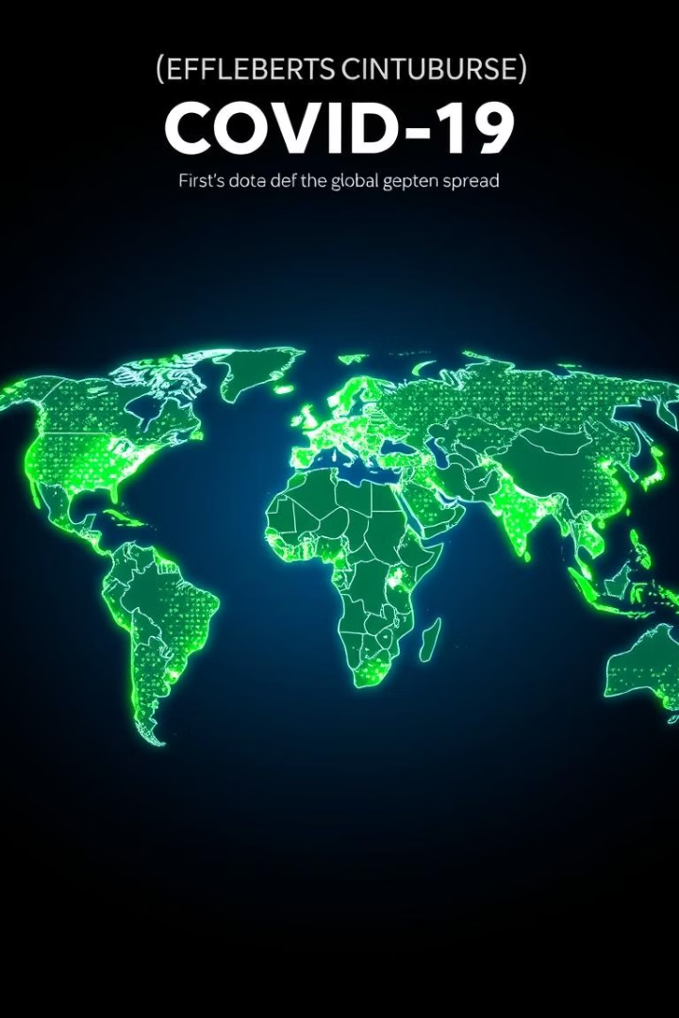
CONCLUSION AND STRATEGIC RECOMMENDATIONS
COVID-19 HAS SHOWN THE IMPORTANCE OF GLOBAL COOPERATION AND ROBUST PUBLIC HEALTH SYSTEMS.
COUNTRIES LIKE CHAD HIGHLIGHT THE NEED FOR EQUITABLE VACCINE ACCESS.
THE UK’S RESURGENCE DUE TO NEW VARIANTS EMPHASIZES THE NEED FOR ONGOING VIGILANCE AND BOOSTER CAMPAIGNS.
INDIA’S LARGE-SCALE VACCINATION SUCCESS DEMONSTRATES THE POWER OF INFRASTRUCTURE AND PUBLIC ENGAGEMENT.
SUSTAINED EFFORTS ARE ESSENTIAL TO PREVENT FUTURE PANDEMICS AND CREATE A HEALTHIER, SAFER WORLD

Slide 10
THANK YOU!
FOR YOUR ATTENTION

